Slide 1
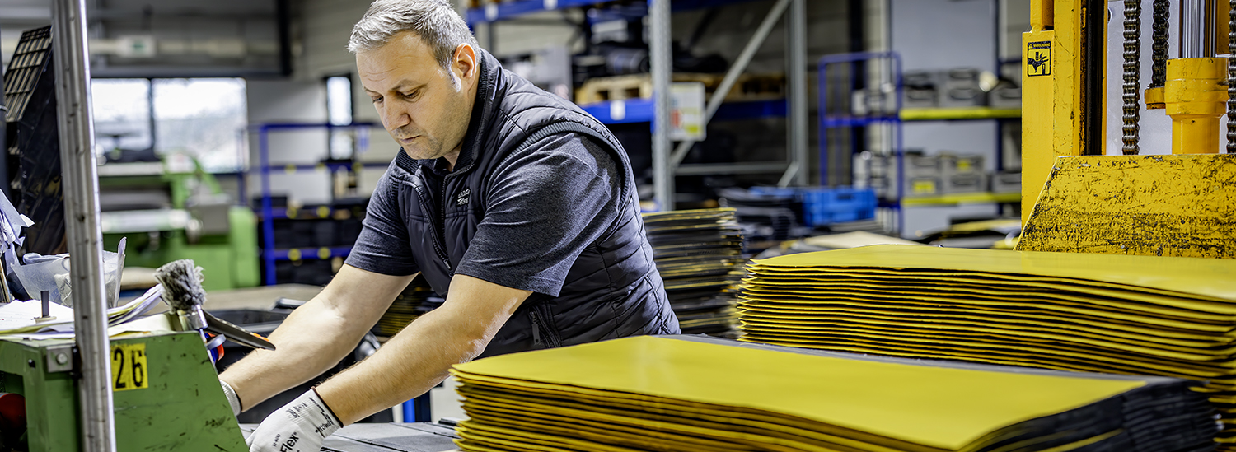
Work Pressure Toolbox
Company name and date
Notes:
Tip:
Read the manual for this toolbox as it explains how to organise the toolbox.
To prepare, take a look at the other Work Pressure resources on the 5xBetter website.
Example introduction by the toolbox leader:
Welcome to the toolbox on work pressure. Work pressure is a topic that affects us all, whether we do physical work, sit behind a computer, or coordinate work. It's about the amount of work, the speed at which it has to be done and the pressure we feel to do everything well. A healthy amount of work pressure can motivate us and give us energy. However, too much pressure or pressure that remains high all the time can cause stress, reduce productivity and affect health. It is therefore important to be aware of work pressure, recognising when it becomes too high, and knowing what we and the company can do to reduce it.
This work pressure toolbox looks at various aspects of work pressure. We explore what work pressure is, what signs indicate that the pressure is too high and what measures can be taken to deal with it. The aim is not only to recognise problems, but also to provide practical tools to help us discuss and manage work pressure together.

Slide 2

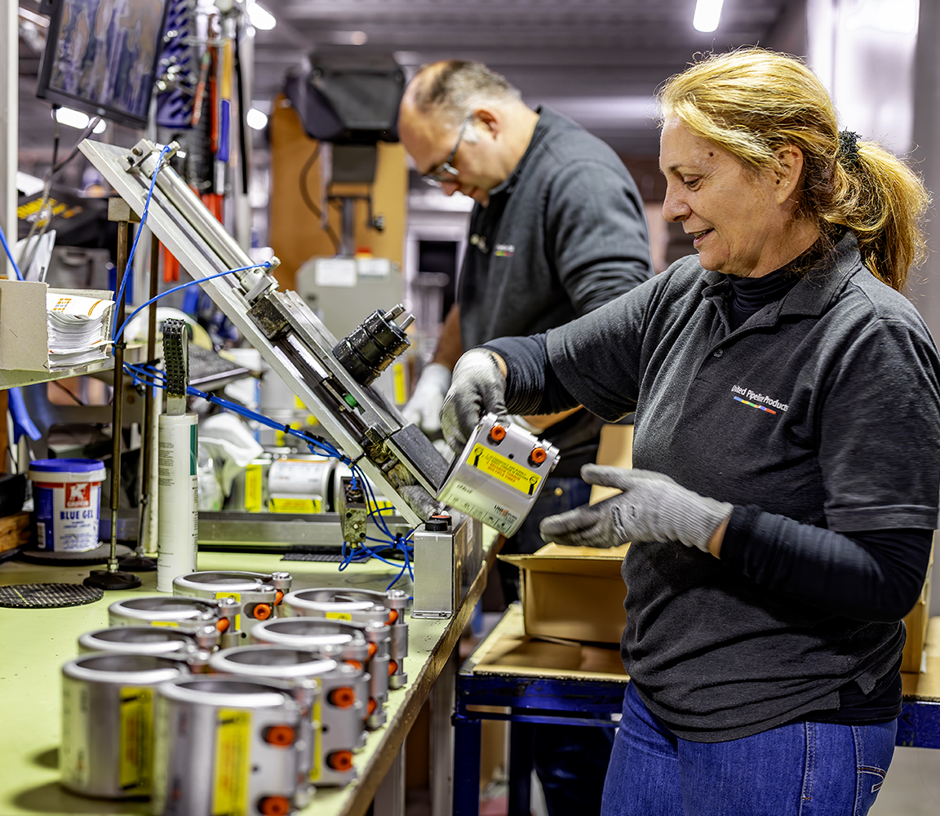
What can we do?
Safe and healthy working practices | Work pressure
What is work pressure?
Energy boosters and energy drainers
How do you recognise signs of stress?
What can you do to combat work pressure?
Notes:
Tip for the toolbox leader:
Briefly go through the programme with the participants to clarify which topics will be discussed.

Slide 3
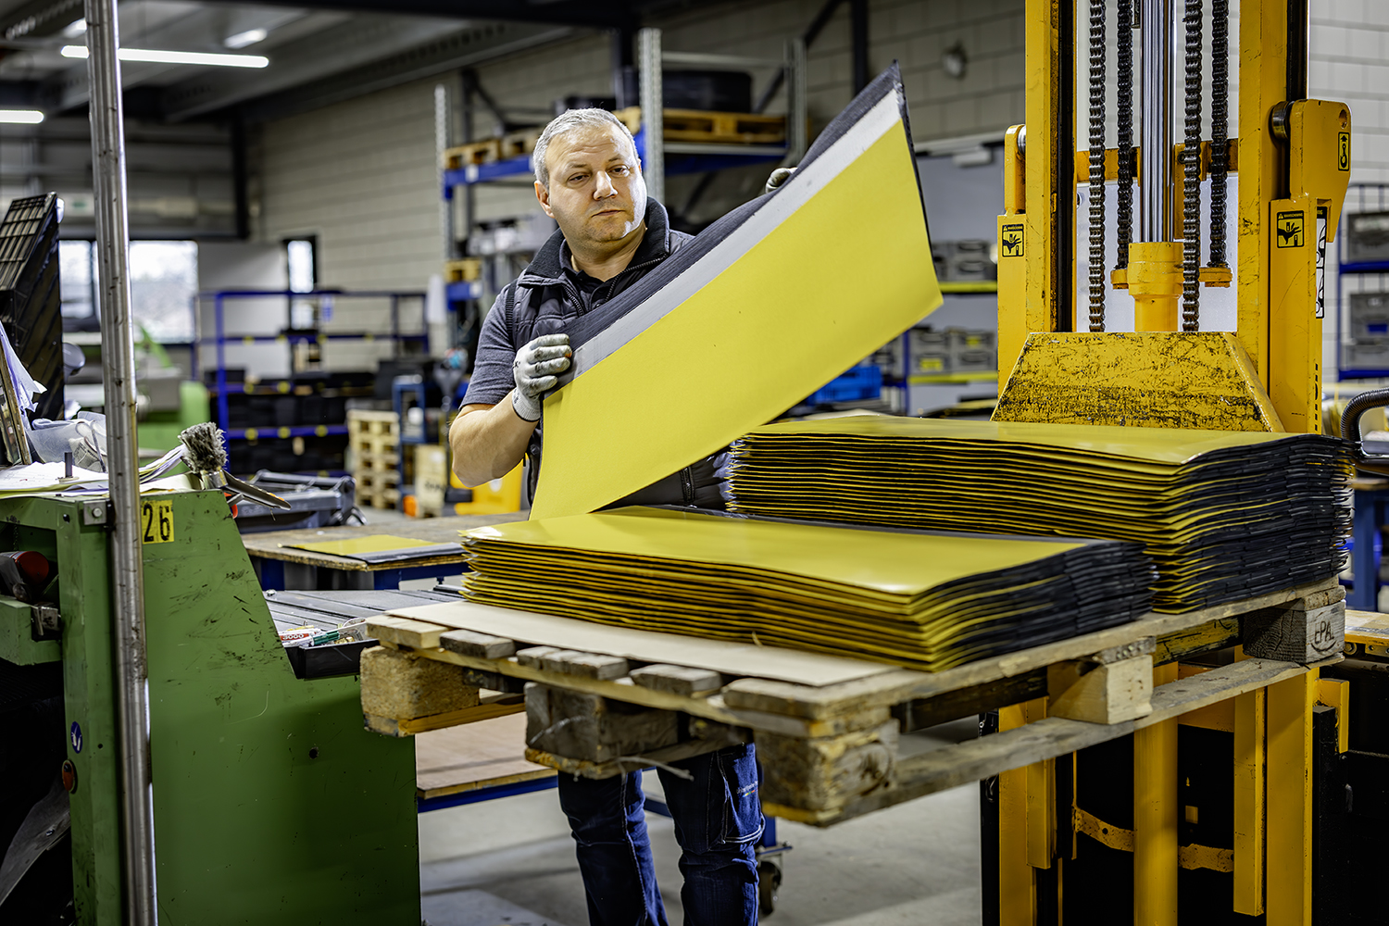
What do you understand by work pressure?
Safe and healthy working practices | Work pressure
Notes:
Note for the toolbox leader:
Interaction with the group: ask what everyone individually understands by work pressure. What is work pressure and is it the same for everyone?
Briefly discuss the similarities and differences.
Tip:
Ask everyone to write their own perception on a post-it note and stick it on the wall, so that you can then look together at what everyone understands by work pressure.

Slide 4
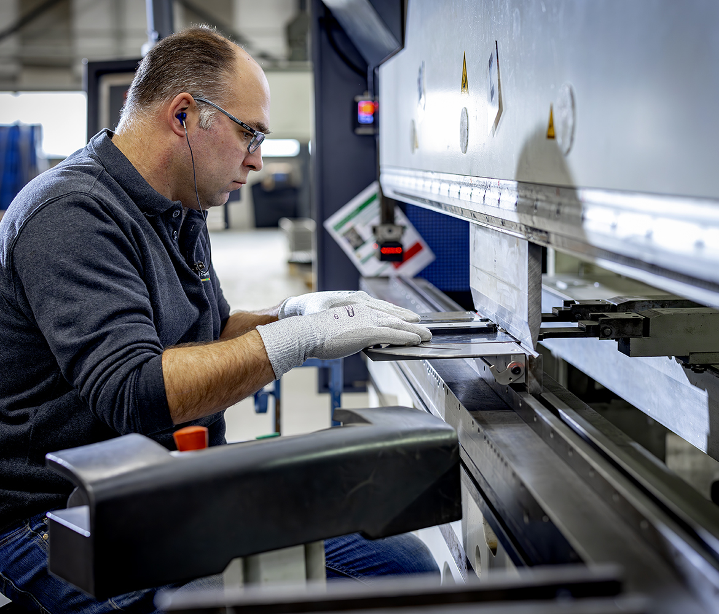
What is work pressure?
Safe and healthy working practices | Work pressure
Work pressure is the amount of work you are asked to do and the time and resources you have to do that work properly.
Excessive work pressure can lead to stress, illness, absenteeism and mistakes.
Notes:
Note for the toolbox leader:
Explain that work pressure:
- Is sometimes necessary (healthy pressure can be motivating)
- Becomes a problem when it is structurally too high
- Can vary from person to person

Slide 5
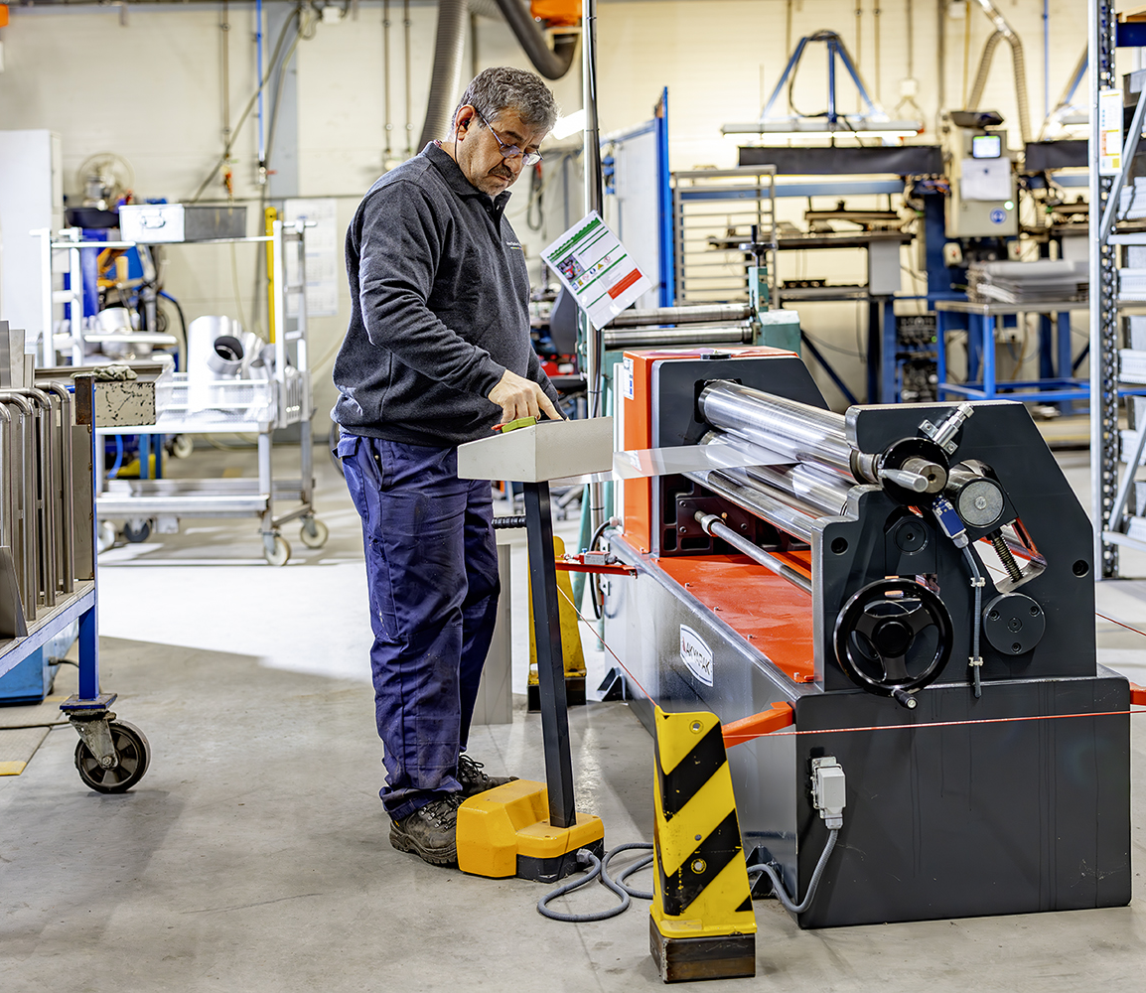
In or out of balance?
Safe and healthy working practices | Work pressure
Work pressure reflects the balance between energy boosters and energy drainers.
If there is no balance between the two, then there is unhealthy work pressure and work stress arises.
Notes:
Note for the toolbox leader:
Explain:
Energy boosters = things at work that motivate you or give you satisfaction.
Energy drainers = things that cause frustration, irritation or fatigue.
If the two are in balance → healthy work pressure. If energy drainers predominate → work stress.

Slide 6
Energy loss
Safe and healthy working practices | Work pressure
Energy drainers are situations, behaviours and people that leave you feeling tired, drained or even exhausted:
high production standards and tight deadlines
too few employees for the amount of work
physically demanding work
complex tasks, inability to meet task requirements
insufficient support or resources
poor relationship with colleagues or manager
Your personal situation and character can also be energy drainers.

Slide 7
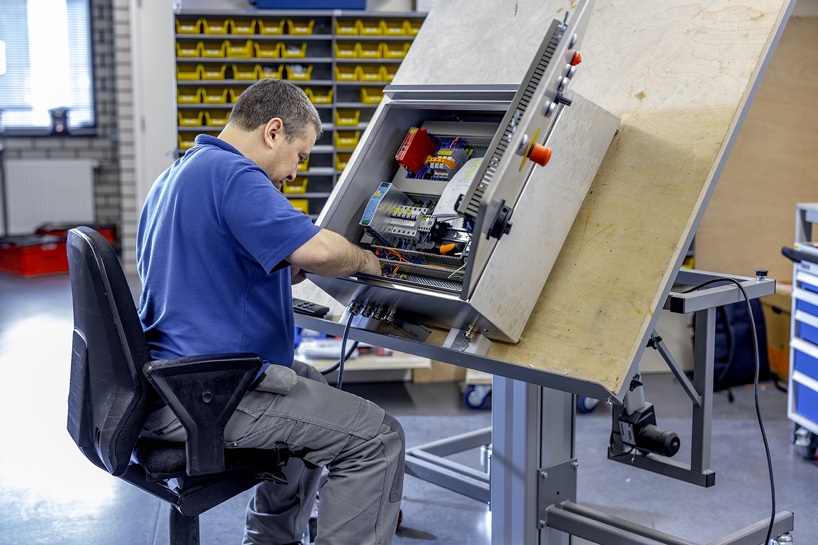
What are your energy drainers?
Safe and healthy working practices | Work pressure
Notes:
Note for the toolbox leader:
To prevent work stress, it is important that we know what drains our energy. That is why I want to hear from you: what are the real energy drainers in our work?
Emphasise:
- This is not about complaining.
- This is about improvement.
Treat all matters raised with respect.
Explore one or two points briefly.
Ask, for example:
“What does this cost so much energy?”
“What happens when this occurs frequently?”
“What does this mean for safety or quality?”

Slide 8
Energy boosters
Safe and healthy working practices | Work pressure
Energy boosters are situations, activities or habits that recharge you and give you a sense of well-being and vitality.
Examples:
support from colleagues and managers
autonomy
positive feedback on work
good training opportunities

Slide 9
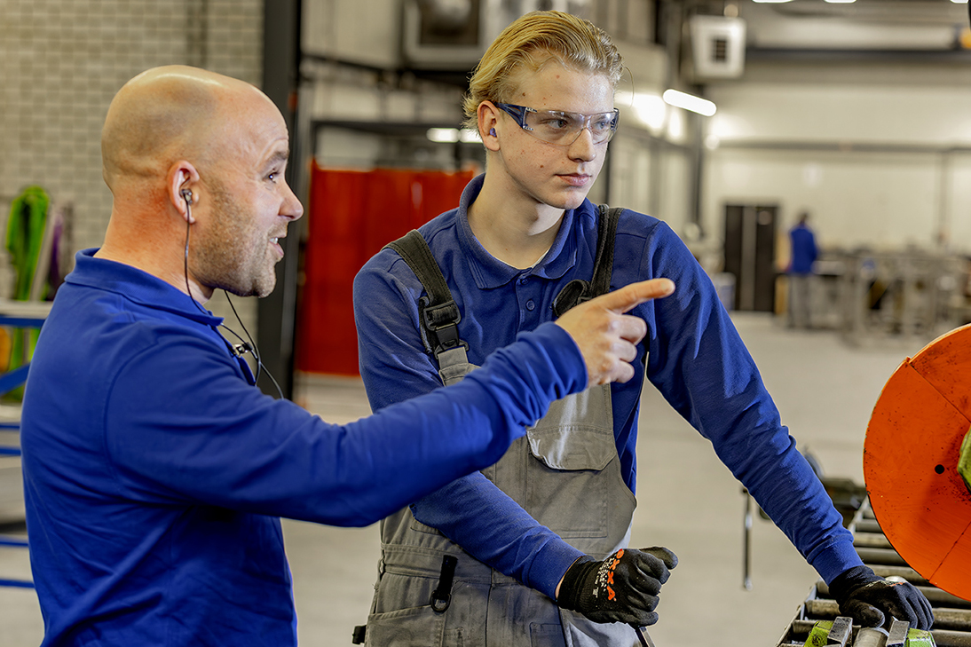
What are your energy boosters?
Safe and healthy working practices | Work pressure
Notes:
Note for the toolbox leader:
To maintain a healthy workload, it is just as important to know what gives us energy in our work. These are the things that keep you motivated and make you enjoy your work.
Emphasise:
- It's about positive energy and motivation
- Treat all matters raised with respect.
This helps us to balance energy drainers
Explore one or two points briefly.
Ask follow-up questions:
“Why does this give you energy?”
“What happens if you can do this often?”
“How does this contribute to safe working practices and good results?”

Slide 10
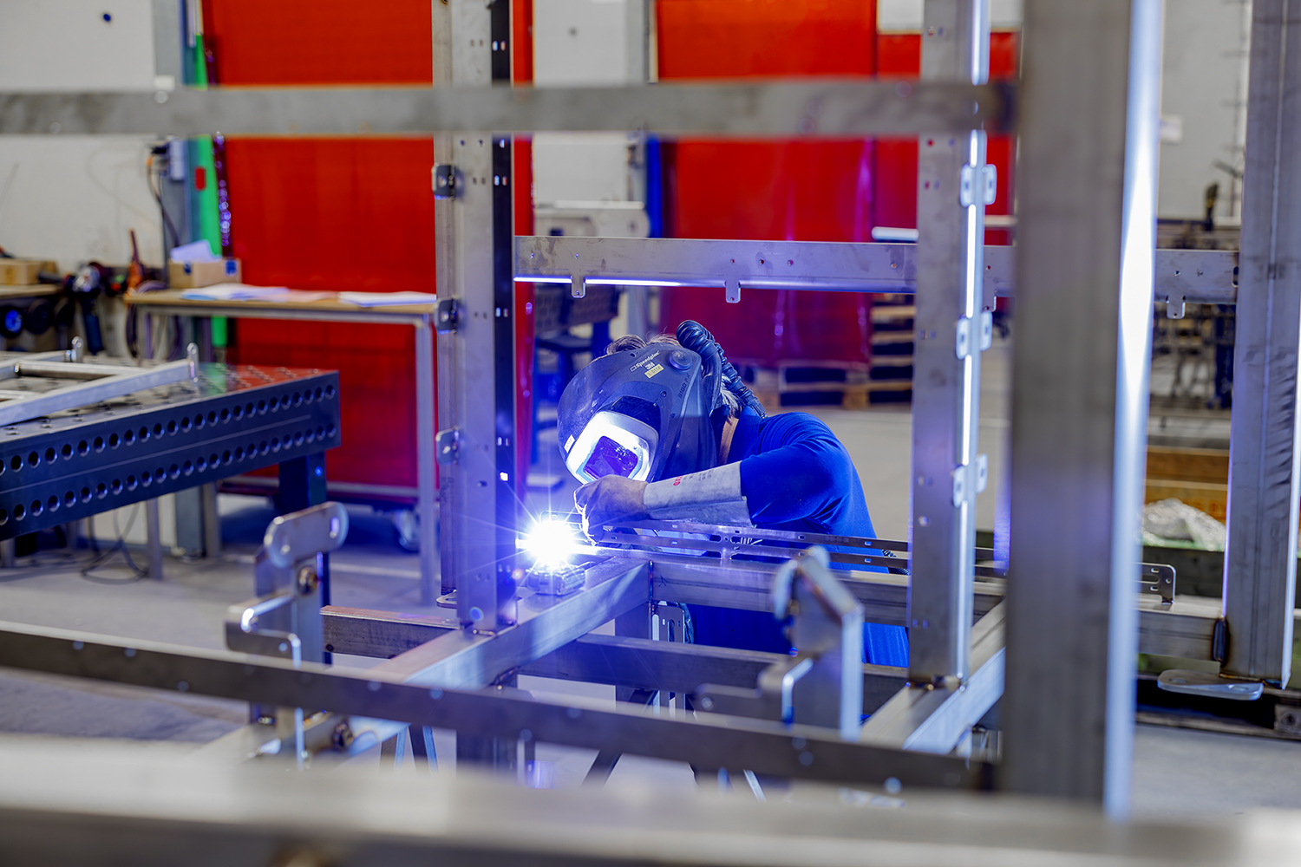
Is work pressure a bad thing?
Safe and healthy working practices | Work pressure
Notes:
Note for the toolbox leader:
With this question, we want to gauge how the group experiences work pressure and discuss whether this could become a problem. Work pressure in itself is not always bad, but excessive work pressure can lead to stress, mistakes and absenteeism.
Emphasise:
- Work pressure is normal in any job
- It only becomes “bad” when it is excessive for a long period of time and is not balanced with energy boosters

Slide 11
Is work pressure a bad thing?
Safe and healthy working practices | Work pressure
Work pressure is not a problem if:
it does not last too long,
peaks are followed by quiet periods (during which you can recover),
the causes are addressed so that work pressure does not lead to work stress.
Notes:
Note for the toolbox leader:
Work pressure is not always a bad thing. Sometimes it is part of the job and can even be motivating. It only becomes unhealthy when it is structurally too high and there are no opportunities for recovery. That is why we look at the conditions under which work pressure is not a problem.
If necessary, explain the three conditions mentioned:
It does not last too long.
Short-term pressure can give energy and increase motivation.
Prolonged high work pressure leads to fatigue and stress. Example: a busy day when everything has to be finished on time → fine, as long as there are moments of rest afterwards.
Peaks are followed by quiet periods (opportunities for recovery)
Our bodies and minds need time to recover.
Without recovery, pressure builds up → increased risk of errors and illness. Example: after a busy week, a quiet week or sufficient breaks during the working day.
Causes are addressed so that it does not lead to further work stress.
Work pressure that keeps coming back without a solution becomes unhealthy.
It is important to discuss problems and address structural causes. Example: planning that keeps changing, missing materials → solve together with manager.

Slide 12
Signs that the work pressure is too high
Safe and healthy working practices | Work pressure
You often feel rushed or stressed.
You have difficulty concentrating or making decisions.
You have complaints such as headaches, back pain or fatigue.
Your work and private life are becoming unbalanced.
Notes:
Note for the toolbox leader:
See also the stress signs tool on the 5xBeter website for a comprehensive overview of the various signals.
Tip:
You may wish to print out this overview and ask participants to tick the signs they recognise.

Slide 13
What can you do yourself?
Safe and healthy working practices | Work pressure
Set priorities: what really needs to be done today?
Take breaks and make sure you get some exercise, preferably outdoors.
Divide tasks or ask colleagues for help.
Set boundaries and dare to say no.
Notes:
Note for the toolbox leader:
See also other Work Pressure resources on the 5xBeter website.
TIP:
Gather experiences from the group!
Exchanging experiences; what works for one person can be an inspiration for another.

Slide 14
In short:
Safe and healthy working practices | Work pressure
It is normal to feel pressure, but beware of too much or prolonged pressure.
Raise the alarm in good time if you are suffering from work pressure. Talk about it with your managers or a colleague. Work together to find solutions.
Notes:
Note for the toolbox leader:
Conclude the toolbox on a positive note. Consider using the following techniques:
Inspirational quote or image
Conclude with a short, powerful quote about cooperation or maintaining balance, for example: “Stronger together, even when things get busy.”
Or use a cheerful image that reinforces the message: teamwork, tranquillity, or a balance scale.
Tip of the day or takeaway
Finish with one concrete, practical piece of advice that everyone can apply immediately, such as: “Take 5 minutes every day to plan your working day; this reduces stress and prevents peaks in workload.”

Slide 15

Safe and healthy working practices | Work pressure
Questions?
info@5xbeter.nl | www.5xbeter.nl

Slide 16
Safe and healthy working practices | Work pressure
Need help?
Discuss it with your manager or contact the health and safety officer.
Consult an Improvement Coach from 5xbeter: www.5xbeter.nl
Or call the FREE Improvement Line: 0800 – 55 55 005
info@5xbeter.nl | www.5xbeter.nl

